Slide 1
Case Mangement Portal
Using spring boot and angular

Slide 2
Introduction
Case Management Portal is a digital platform where customers can directly contact to their service provider by creating case notes. Case Management portal makes it easy for customers as well as service provider to communicate with each other and get their issues resolved within short span of time avoiding time delay.

Slide 3
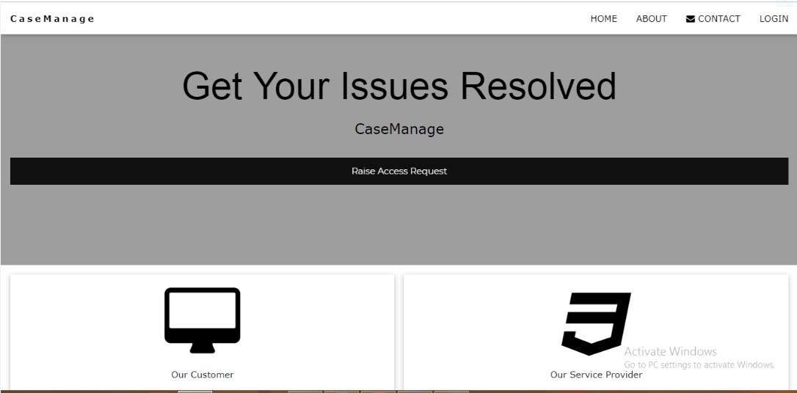

Slide 4
Need of Case Management Portal
The use of cases will vary depending on your type of organization. Typically, cases are used to track and resolve different types of customer issues. When cases are surfaced via a portal, users can create or even comment on cases themselves, bypassing the need to speak directly with people in your organization.

Slide 5
Technologies used in Project
● Spring Boot as Back End
● Angular 7 as Front End

Slide 6
Modules of Case Management Portal
● Customer’s Module
● Service Provider’s Module
● Admin’s Module

Slide 7
Customer’s Module
In First Module of Case Management portal for customers can create note to raise request which will be send to service provider and can upload documents also.

Slide 8
Customer’s Module
● Raise Access Request
● Create Case Note
● Update Case Note
● Delete Case Note
● Display Case Notes
● Download Documentation
● Upload Files
● Download Files
● Watermarking of Uploaded files

Slide 9
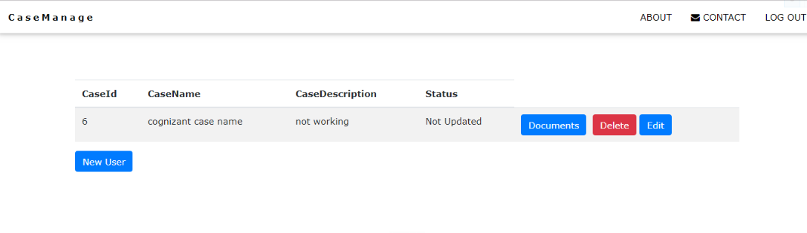

Slide 10
Service Provider’s Module
Service Provider will be able to change the status of case note according to them but will not be able to update note or delete it.

Slide 11
Service Provider’s Module
● Raise Access Request
● View Case Note
● Update Status

Slide 12
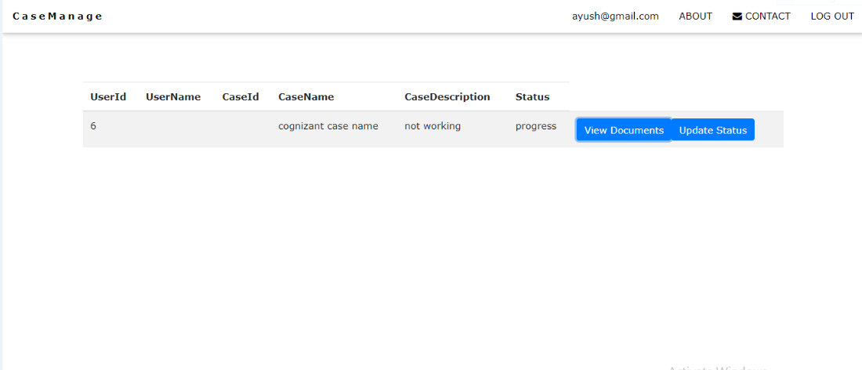

Slide 13
Admin’s Module
Admin grant access rights to all users
Admin can download all the details of request in form of excel File. Admin can also review and update any of the information originally provided in the case record.

Slide 14
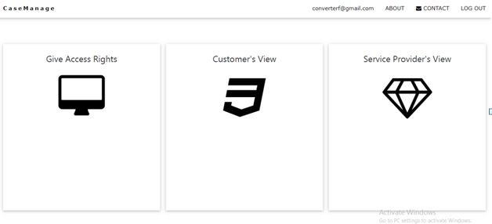

Slide 15
Admin’s Module
Dashboard will be available where admin can perform his tasks and can also see the view of customer’s and service provider’s.
Admin’s Options
● Admin can grant access rights to Customers and Service Provider
● Admin can perform all options performed by customer as well as service provider.
● Admin can download documented Form

Slide 16
Various Functionalities Used in Case Management Portal
● All the basic CRUD Functionalites using SQL database
● Encryption and Decryption using Cryptography Techniques
● Sending SMS using Twilio Messaging API
● Sending Email using Java Mail API
● Converting Details to Excel File using Apache POI
●Watermarking of Uploaded File Using Java Libraries

Slide 17
What’s there to be developed?
Functionalities like screen sharing can be implemented which will assure service provider that requirements of customers are fulfilled .They can show a demo to customers after updation and can get clear idea about their requirement. We can implement a online tool wherein service provider can operate the customers local machine and updation can be done directly on their server. Analysis of request can be done using machine learning tool.

Slide 18
Thank You

